Slide 1


Congratulations
Your next steps

Slide 2
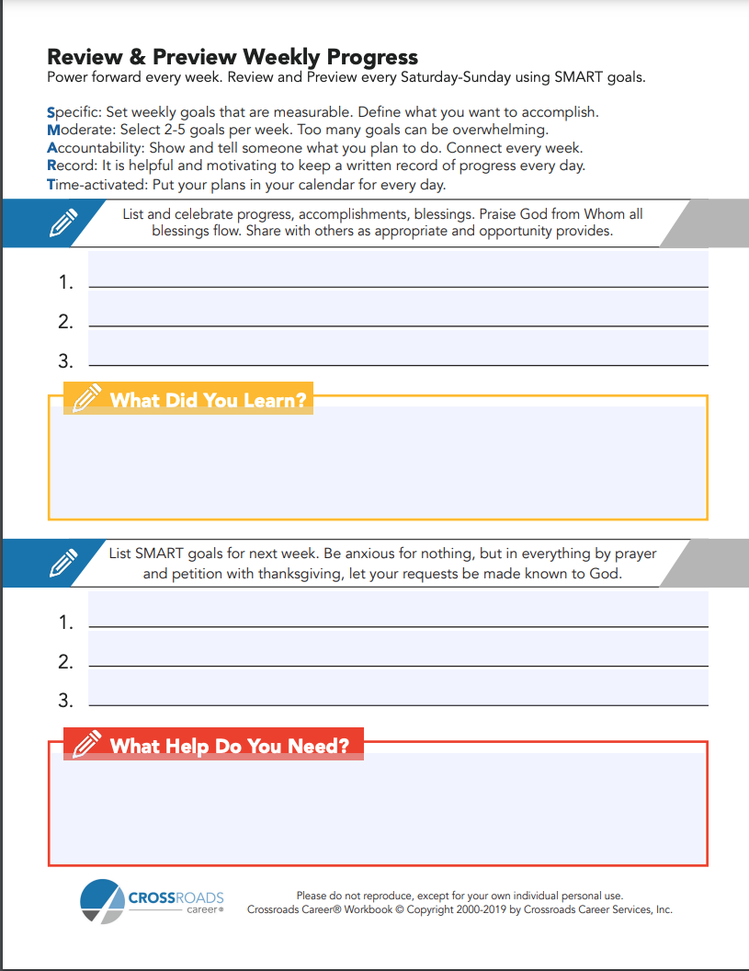
Review & Preview
Each week, continue to use the Review & Preview worksheet to continue making and meeting weekly goals.
https://crossroadscareer.org/wp-content/uploads/partners/Coaching/Review-Preview-Resource.pdf

Slide 3
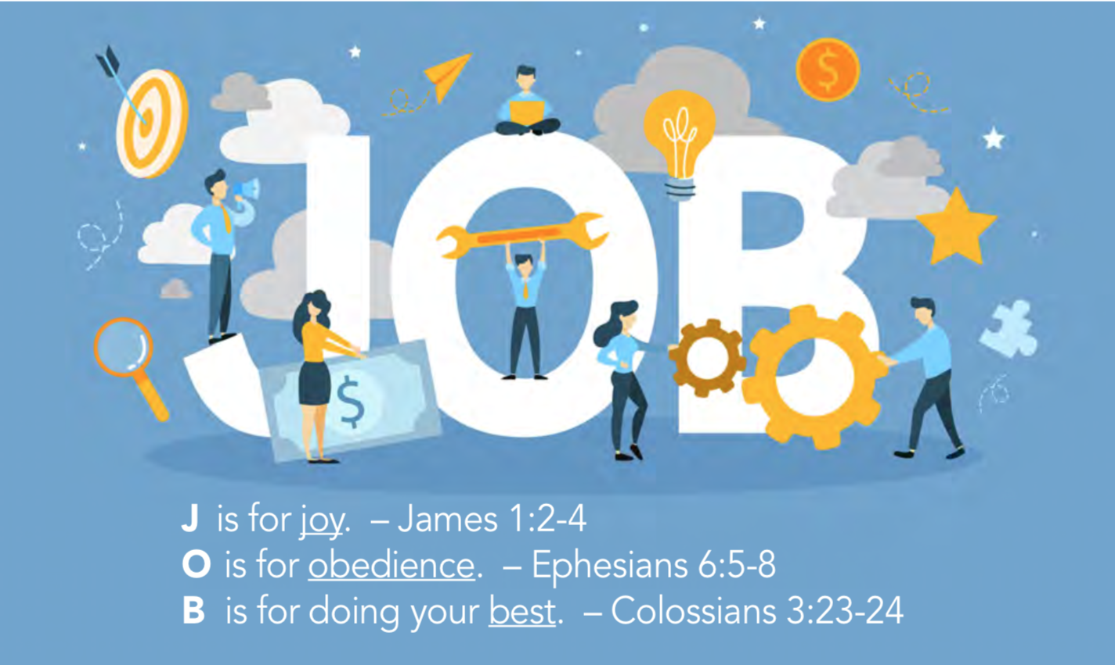
Do your J-O-B

Slide 4
Your Next Steps
In which of the 7 steps are you now?
Get coaching for specific needs
This is a journey, not a destination
Start or join a Christ-centered career group
Take StrengthsFinder or Career Direct assessments
Start, join or lead another study
Join or start a career ministry team

Slide 5
Your Next Steps
Find Local Help
Other Career Ministry Offerings
Other Ministries in Church or Community
American Job Centers
http://www.careeronestop.org

Slide 6
Your Next Steps
New Job Jump Start
If you got a new job, read New Job Jump Start. You can study with a buddy or by yourself. Read daily for a month or browse the contents for top hot topics every day.

Slide 7

Your Next Steps
Real Success at Work
If you want to better hear God calling, get Real Success at Work, a 4-chapter individual or group study of Ephesians 2:10 about you as God’s masterpiece.

Slide 8
God’s Masterpiece
For we are God’s masterpiece.
He has created us anew in Christ Jesus, so we can do the good things he planned for us long ago.
(Ephesians 2:10 NLT)

